Slide 1
Game Design Principles

Slide 2
What are principles?
Tools that you can use to effectively design a game
Numerous number of principles get used
Probably get used unintentionally
More aware of what you use the more effective you can use them
Let's look at some common ones!

Slide 3
Top Down / Bottom Up
Concepts
Mechanics

Slide 4


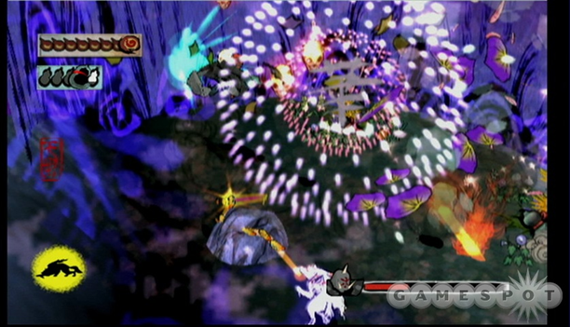

Feed Back Loop
player input -game responds – player input

Slide 5
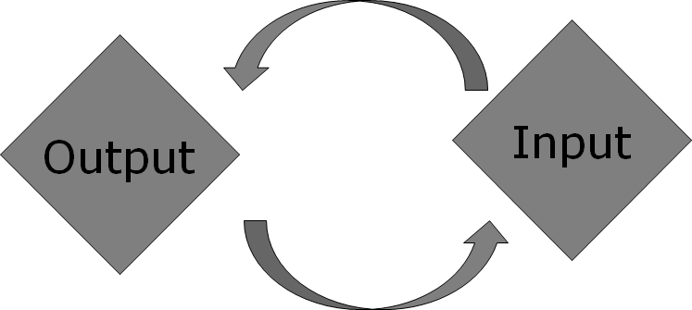

Slide 6
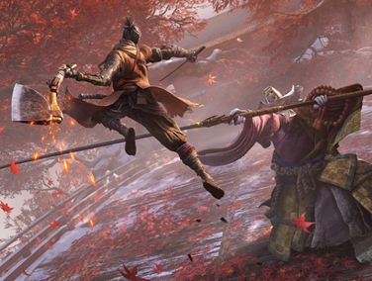
Flow
Adapt the difficulty of the game to the players skill level
Allow a “Cool off period” for the player to display their mastery

Slide 7
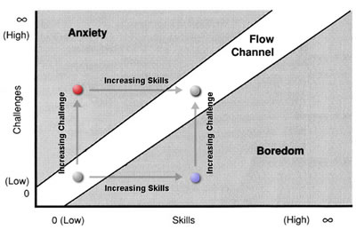
Flow
This Photo by Unknown author is licensed under CC BY-SA.

Slide 8
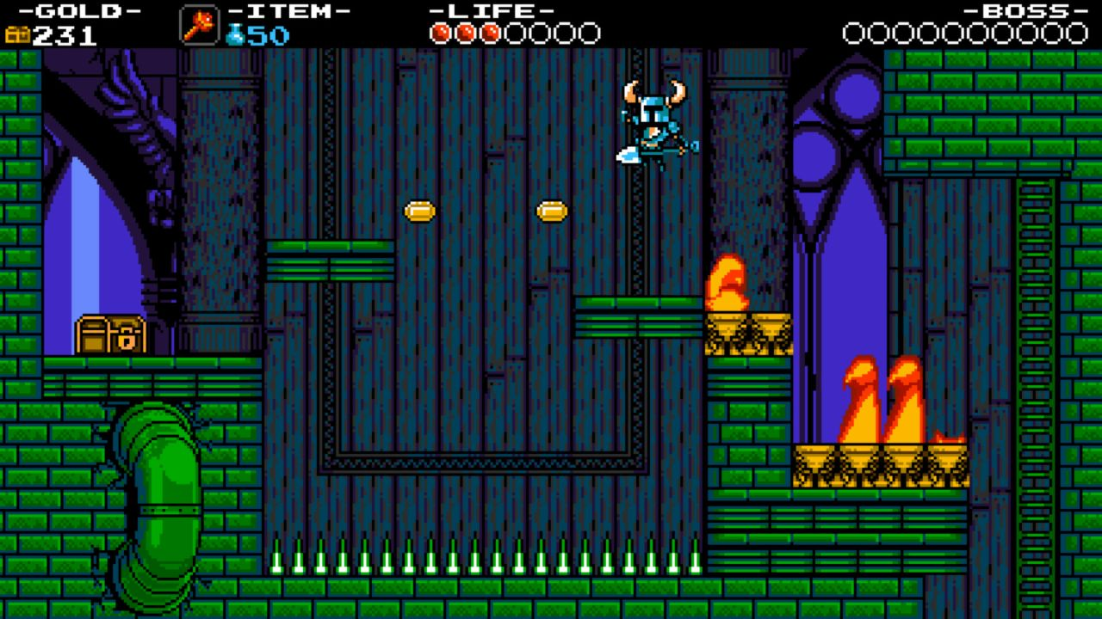
Thesis, Antithesis, Synthesis (Goal, Conflict, Result)
What does the player want to accomplish
What stops the player from completing the goal
What happens when the player interacts with the conflict

Slide 9
Agency
What can the player control in the game?
What is the balance between luck vs strategy?
How the balance of agency influence the feel of the game?

Slide 10
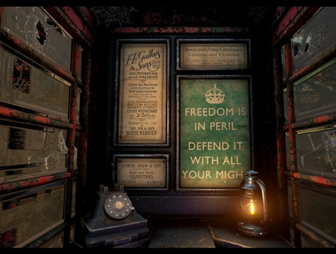
Environmental Storytelling
Using the design and aesthetic of the level to deliver a message

Slide 11
Golden Path
Used in level design, the "default path" in which the player experience the game
Often couple with the "Content Path" in which the player experience the most content
How are you marking the golden path?
What punishment / rewards are you giving the player for deviating?

Slide 12

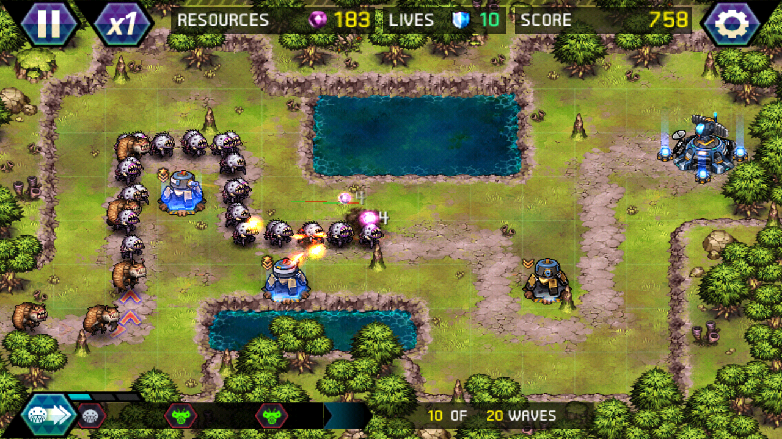
Iteration
Much like development game play iteration has the player repeating an action in different contexts

Slide 13
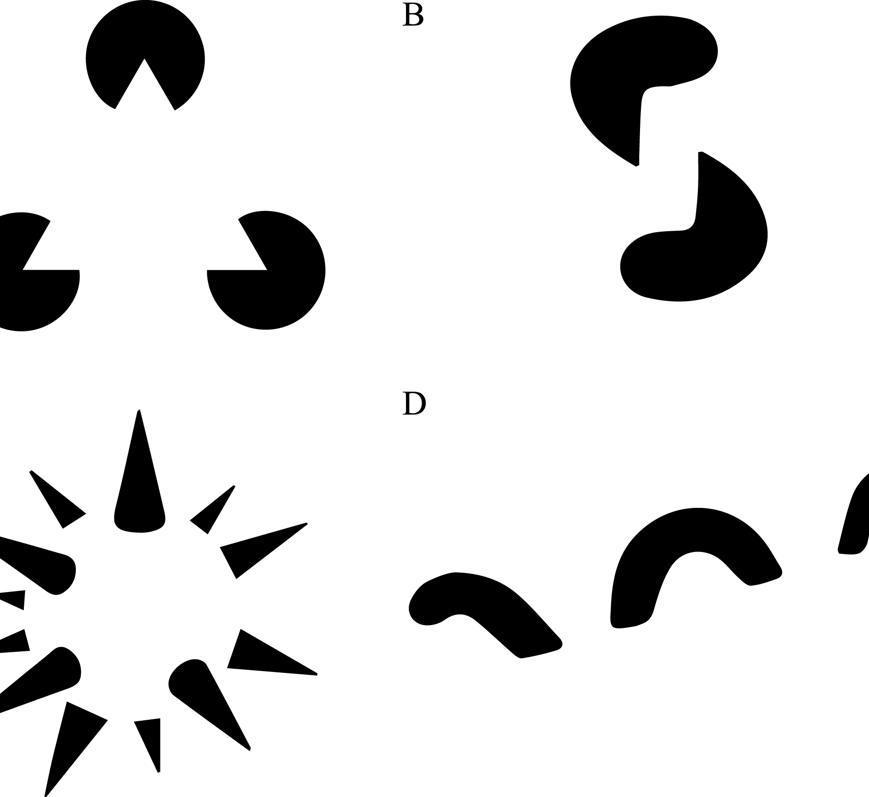
Gestalt
"The whole is greater than the sum of its parts"
Can apply to the games visuals, systems, player controls etc
This Photo by Unknown author is licensed under CC BY-SA.

Slide 14
Gestalt principles
Closure/reification: we see whole objects, even when components are missing
Continuance: we tend to see continuous figures not the pieces
Similarity: we group things together that are similar
Proximity: we group things that are close together
Symmetry: we group things that create balance
Invariance: distorted objects attract attentions
Figure ground: we tend to see one image at a time

Slide 15
Game Pillars
The features of the game that "hold up" the entire game
My Cool Game
Feature #1
Feature #2
Feature #3

Slide 16
The 80/20 Rule
80 percent of the game will be experienced by 20 percent of the features
Prioritizes when and how much time a feature should be developed

